Slide 1



What is Schema Enforcement or Schema Validation in Databricks?

Slide 2

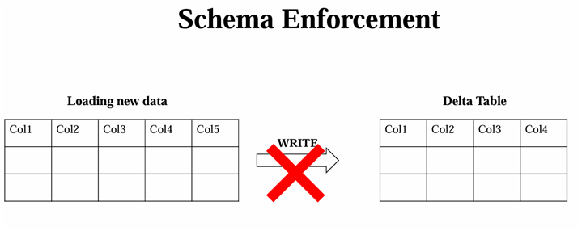



Schema Enforcement or Schema Validation
Let’s take a delta table, which is maintained strictly, we are ingesting data into this table on daily basis.
In one ingestion, if a new data is coming with new “Column” which is not available in this schema.
Now on a fine day during the data ingestion some data comes with a new column which is not in the schema of our current table, which is being overwritten to the location where our delta lake is present.
Dr Sachin Saxena
Follow on

Slide 3

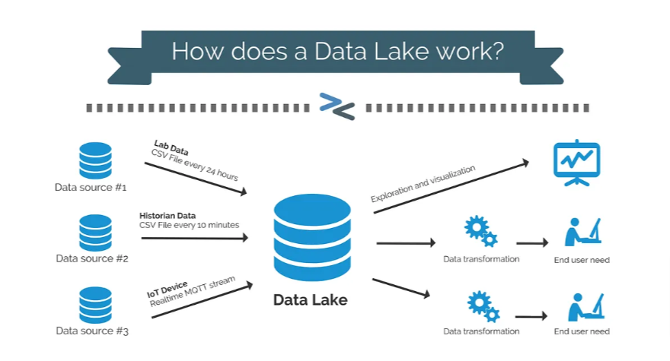
Dr Sachin Saxena
Follow on

Slide 4
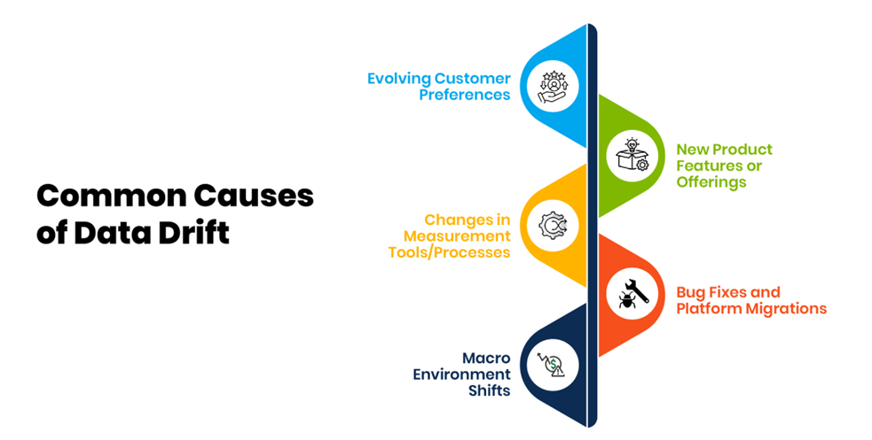

Dr Sachin Saxena
Follow on

Slide 5
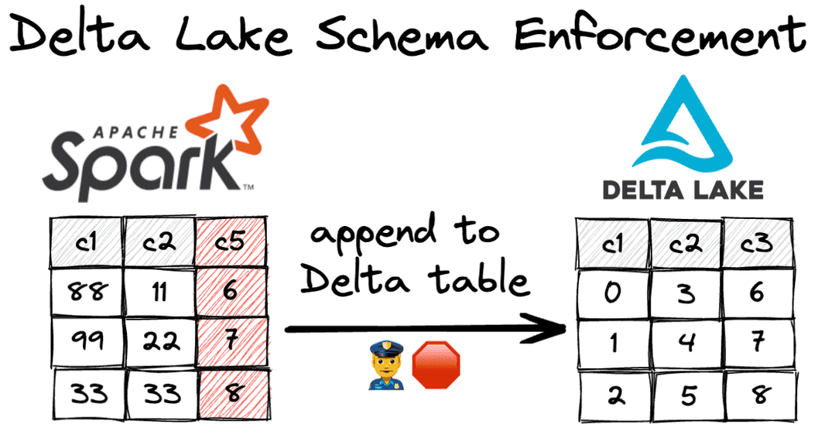
Schema Enforcement or Schema Validation
Schema enforcement, also known as schema validation, is a safeguard in Delta Lake that ensures data quality by rejecting writes to a table that do not match the table's schema.
Like the front desk manager at a busy restaurant that only accepts reservations, it checks to see whether each column in data inserted into the table is on its list of expected columns (in other words, whether each one has a "reservation"), and rejects any writes with columns that aren't on the list.
Dr Sachin Saxena
Follow on

Slide 6


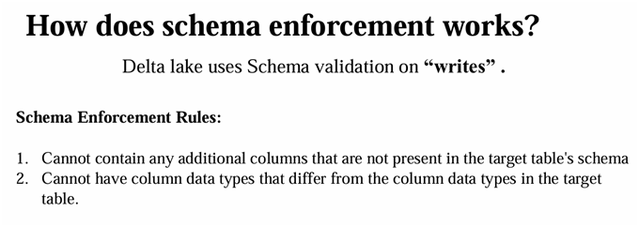
Dr Sachin Saxena
Follow on
Now, generally, if you are using the data lake and I'm mentioning it again to prevent any confusion, I mean the data lake, not the delta lake, the general data lake will allow the overwriting of this data and we will lose any of our original schema.
But coming to the Delta Lake, we have a feature called schema enforcement or Schema validation, which will check for the schema for whatever the data that is getting written on the Delta Lake table.
Schema enforcement acts as a gatekeeper who checks for the right data to enter to the Delta Lake.
Now how is this schema enforcement useful?
Because it is such a stringent check, schema enforcement is an excellent tool to use as a gatekeeper to get a clean, fully transformed data set that is ready to use for production or consumption.
It is typically enforced on tables that directly fed into the machine learning algorithm by dashboard or data analytics or visualization tools, and schema enforcement is used for any production system that is requiring highly structured, strongly typed semantics checks.

Slide 7
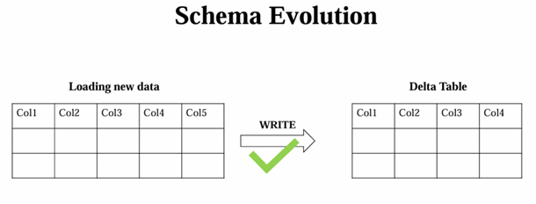
Schema Evolution:
Schema evolution in Databricks Delta Lake enables the flexible evolution of table schemas, allowing changes such as adding, removing, or modifying columns without the need for rewriting the entire table. This flexibility is beneficial for managing changes in data structures over time.
So schema evolution is a feature that allows the user to easily change the tables current schema to accommodate the data changing over time.
Dr Sachin Saxena
Follow on

Slide 8
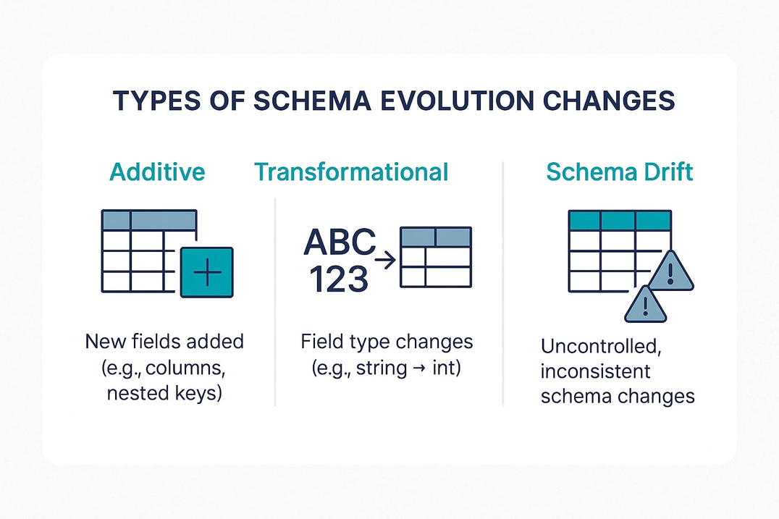
Schema Evolution:
Schema evolution is a feature that allows users to easily change a table's current schema to accommodate data that is changing over time. Most commonly, it's used when performing an append or overwrite operation, to automatically adapt the schema to include one or more new columns.
On the flip side of the coin, schema evolution complements enforcement by making it easy for intended schema changes to take place automatically. After all, it shouldn't be hard to add a column.
Dr Sachin Saxena
Follow on

Slide 9
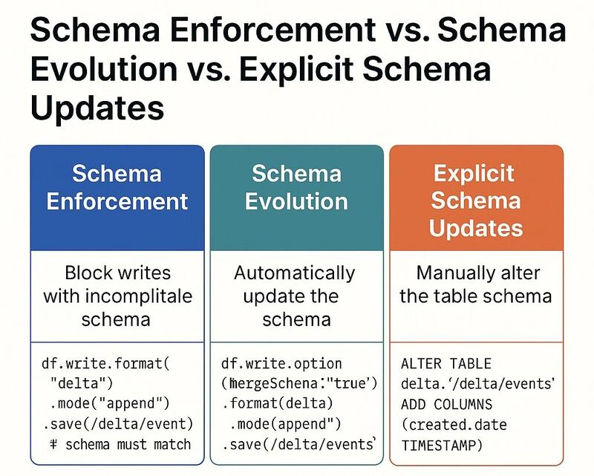
Dr Sachin Saxena
Follow on

Slide 10
𝐐𝐮𝐞𝐬𝐭𝐢𝐨𝐧: How would you handle schema evolution in PySpark?
𝐒𝐜𝐡𝐞𝐦𝐚 𝐞𝐯𝐨𝐥𝐮𝐭𝐢𝐨𝐧 refers to the ability to handle changes in your dataset's structure—
✅ Adding new columns/fields
✅ Dropping existing columns/fields
✅ Changing the datatypes of existing fields.
Dr Sachin Saxena
Follow on

Slide 11
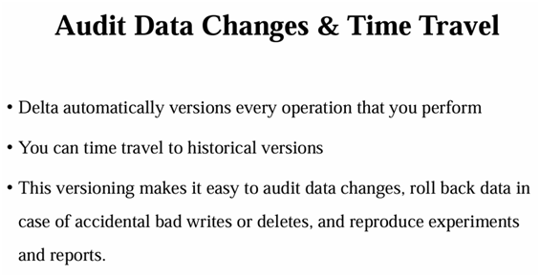
Dr Sachin Saxena
Follow on
Audit Data changes & Time Travel: "Time travel" in Delta Lake enables users to query a historical snapshot of the data at a specific version, facilitating data correction or analysis at different points in time.

Slide 12

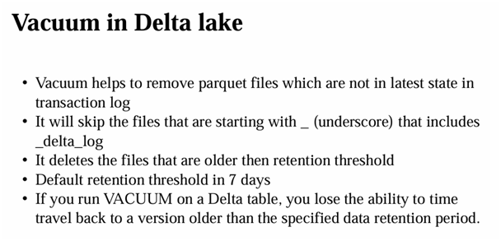
Dr Sachin Saxena
Follow on
Vacuum Command
If you are getting a very high storage cost now, if your organization wish to delete the old data like a 30 days old data, you can make use of the vacuum command.
Now let's see how we can implement this. Now in order to know how many files will be deleted, you can make use of the dry run feature in the vacuum.

Slide 13
Dr Sachin Saxena
Follow on
Vacuum Command
VACUUM removes all files from the table directory that are not managed by Delta, as well as data files that are no longer in the latest state of the transaction log for the table and are older than a retention threshold. VACUUM will skip all directories that begin with an underscore (_), which includes the _delta_log.
Partitioning your table on a column that begins with an underscore is an exception to this rule; VACUUM scans all valid partitions included in the target Delta table.
Delta table data files are deleted according to the time they have been logically removed from Delta's transaction log plus retention hours, not their modification timestamps on the storage system.
The default threshold is 7 days.

Slide 14


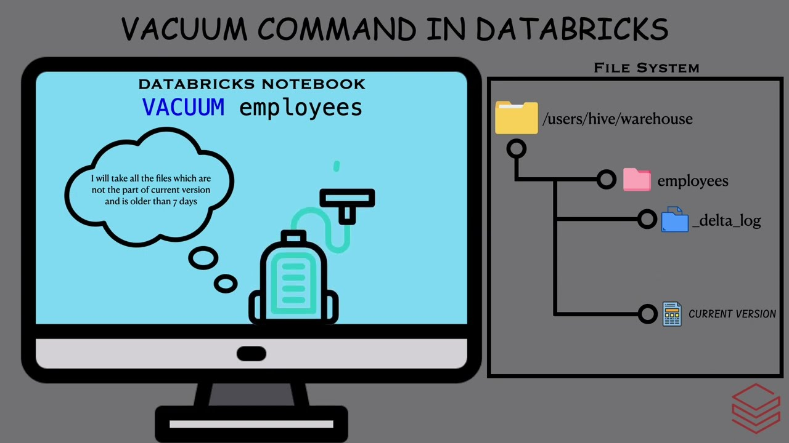
Vacuum Command
Dr Sachin Saxena
Follow on

Slide 15
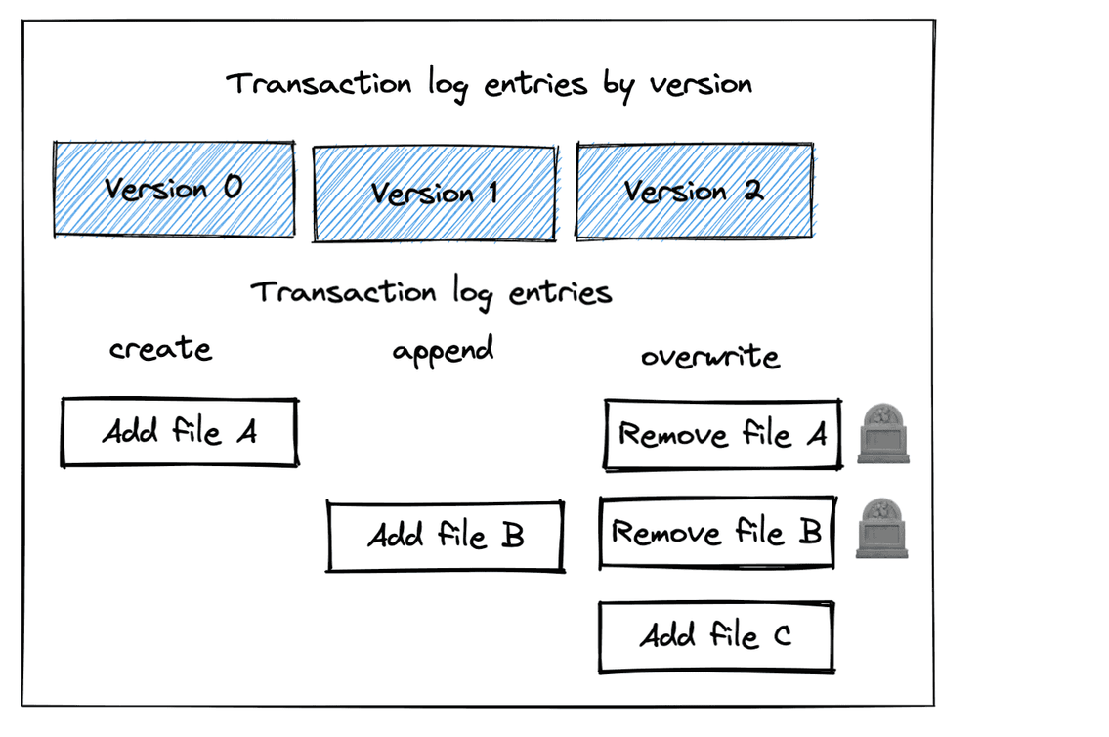
Dr Sachin Saxena
Follow on
Vacuum Command
Running the VACUUM command on a Delta table deletes the unused data files older than a specified data retention period. As a result, you lose the ability to time travel back to any version older than that retention threshold.

Slide 16


THANK YOU
Thank you for your time and attention. We hope this presentation has provided valuable insights into the importance of employee training and development programs
Dr Sachin Saxena
Follow on

